Slide 1


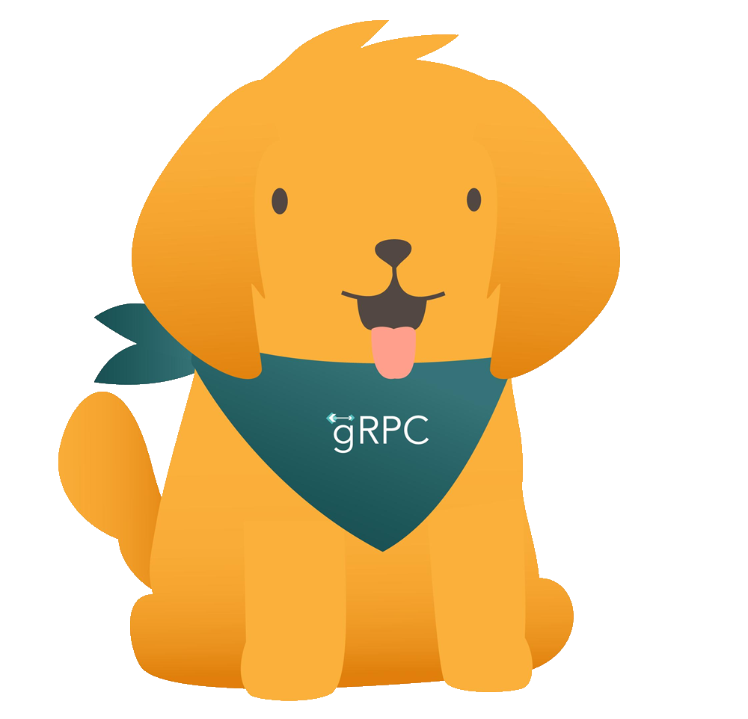
High-performance services with gRPC: What's new in .NET 5
James Newton-King
Notes:
Hi, my name is James Newton-King
I’m an engineer on the .NET team
And today I’m going to talk about gRPC
A modern, high-performance way to communicate between applications

Slide 2
Agenda
What is gRPC
Demo
What’s new in .NET 5
New features
Improved performance
Resources
Documentation
Samples
Notes:
Our agenda for today:
First, introduce gRPC for developers new to it
-compare to RESTful APIs
-I’ll demo building a basic gRPC server and client
Look at what’s new in .NET 5
-A lot of new features have been added in the past year
-Also I’ll focus on gRPC performance. Performance is a big draw for gRPC and there are a lot of improvements here
Finally, for anyone interested in learning more, I’ll talk about the many resources to help you get started

Slide 3

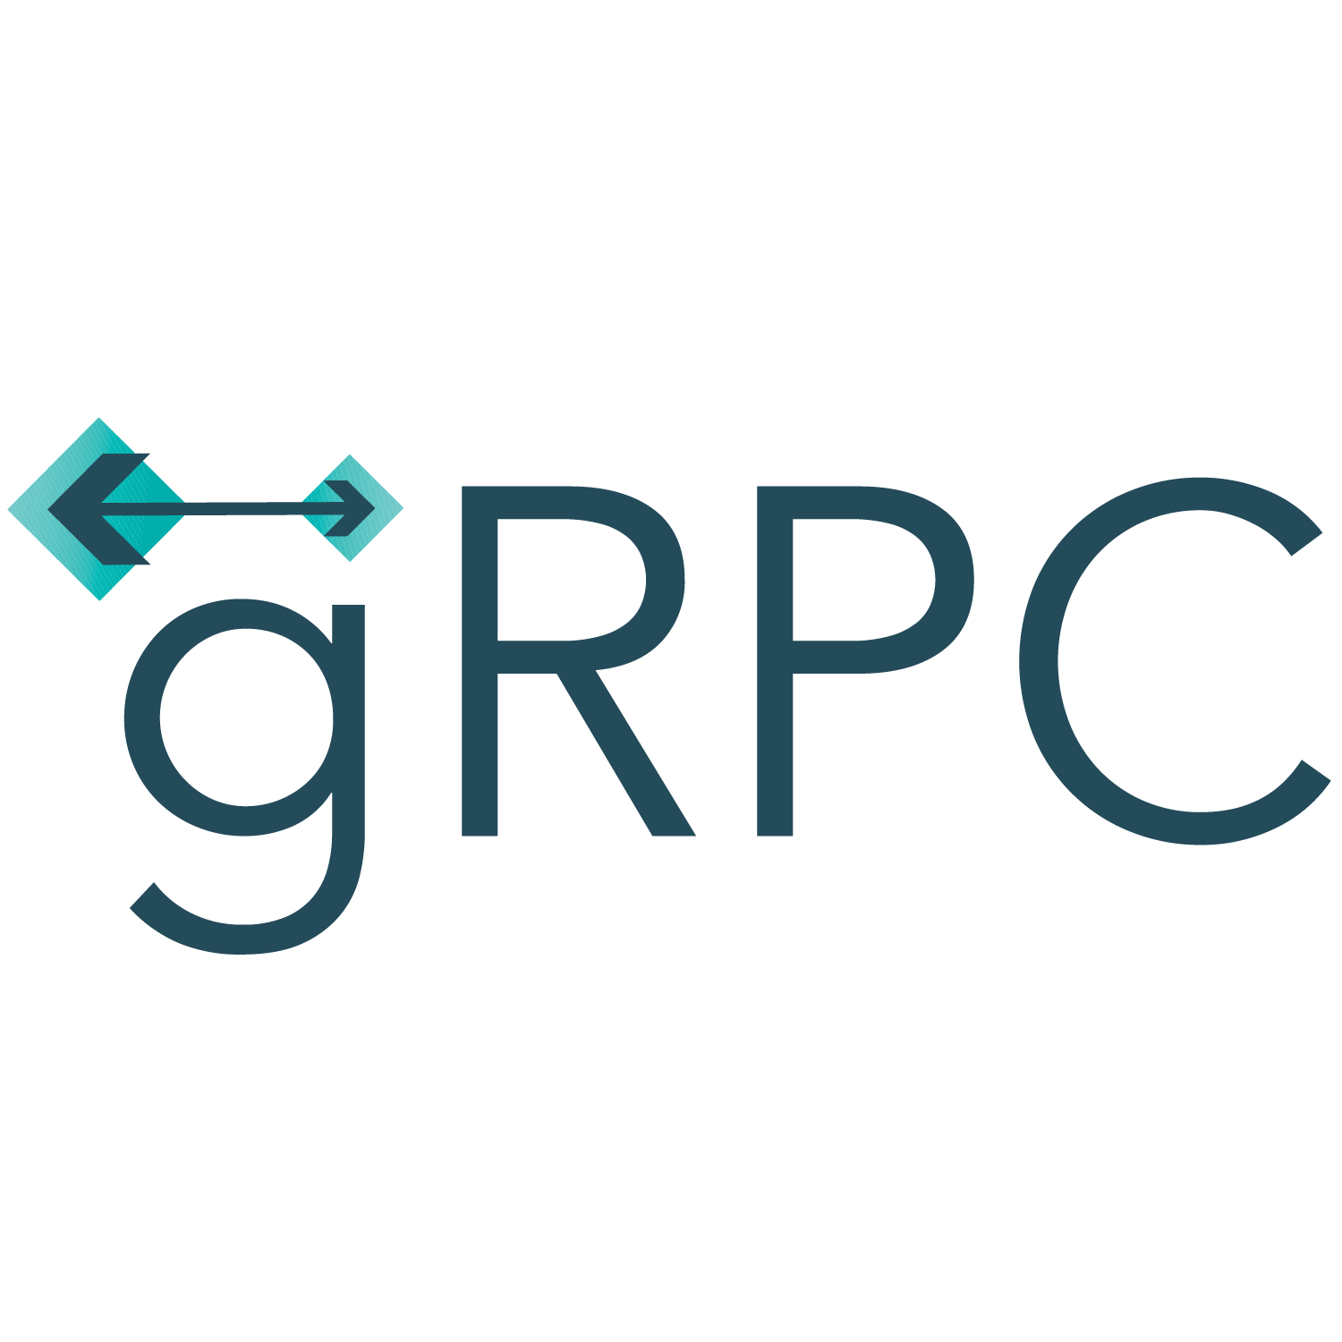


gRPC is…
Popular open source RPC framework
Largest RPC mindshare
Cloud Native Computing Foundation project
Built with modern technologies
HTTP/2
Protobuf
Designed for modern apps
High performance
Platform independent
+
=
Notes:
Popular open source remote procedure call framework
-RPC frameworks make it easy for apps to talk to each other
-There are alternative RPC frameworks, e.g. Thrift, JSON-RPC, WCF
-Developer community is unifying behind gRPC
-gRPC is run by CNCF. Microsoft contributing to CNCF
gRPC is not new, open sourced in 2015
-Union of two technologies, HTTP2 and Protocol Buffers
Designed for modern apps, particularly microservices
-High performance
-Platform independent. There are gRPC implementations for every major programming language today

Slide 4

Remote Procedure Calls vs HTTP APIs
Remote Procedure Calls
HTTP APIs
Contract first (proto file)
Content first (URL, HTTP method, JSON)
Content is for computers
Content is for humans
Hides remoting complexity
Emphasises HTTP
Performance
Developer productivity
Widest audience
Ease of getting started
Notes:
gRPC is an opination contract-first RPC framework
-The proto file is at the heart of gRPC
-Language neutral
-Drives code generation
HTTP APIs focus on the shape and content of HTTP (contract optional)
gRPC content is binary. HTTP/2 and Protobuf are binary and designed for performance
HTTP APIs are text based. HTTP/1.1 are JSON are human readable, great for debugging, not so good for performance
gRPC is designed to hide complexity of remoting
-gRPC libraries plus code generation means you don’t have to worry about routing, headers and serialization.
HTTP APIs emphasise HTTP. There is a lot of control over HTTP requests, but some complexity because of that.

Slide 5
Demo
Create gRPC service using template
Create gRPC client
Call service
Notes:
Create gRPC project in VS
Talk through proto – messages, service, this is the contract
Talk through service – generated file, F12, location, ILogger (DI)
Launch. Browse to server
Create client project – add packages, add proto
Look at service references
Update Program.cs

Slide 6


What’s new in .NET 5
gRPC-Web browser support
gRPC-Web server middleware
gRPC-Web Blazor client
New gRPC hosts on Windows
HTTP.sys
IIS
Inter-process communication
.NET 5 aggressive trimming
Notes:
gRPC is now supported in the browser with gRPC-Web
-gRPC-Web modifies HTTP requests so they can be used from a browser
-.NET have has server middleware and a Blazor client that enables gRPC-Web in minutes
.NET 5 supports gRPC hosted by HTTP.sys and IIS
-Note that Windows changes were needed to support this
-Insiders build of Windows is required
gRPC is a great choice for communicating between processes
-gRPC client and server can now use efficient IPC transports like Unix domain sockets and named pipes
.NET 5 introduces trimming to reduce app size. You can use that today with gRPC
-Because of code generation, gRPC has excellent support for the most aggressive trimming levels

Slide 7

Performance – HTTP/2
HTTP/2 multiplexing
Multiple calls via a TCP connection
Avoid head-of-line blocking
Notes:
Performance is a big draw for gRPC. Lets talk how gRPC gets its performance and what we’ve done to make it even faster in .NET 5
gRPC is designed for HTTP/2 or greater, and benefits from performance improvements in HTTP/2. One of those is multiplexing requests over a TCP connections

Slide 8
Performance – Bandwidth
Low network usage
HTTP/2 binary framing and header compression
Protobuf message serialization
{
"query": "myQuery",
"page_number": 42,
"result_per_page": 100,
"tickers": [
{
"name": "rPs",
"value": 9.768923
},
{
"name": "WEo",
"value": 6.067048
}
]
}
5052 4920 2a20 4854 5450 2f32
0d0a 534d 0d0a 0d0a 0000 0004
0000 0000 0401 0000 0000 0000
syntax = "proto3";
package sample;
message Test {
string query = 1;
int32 page_number = 2;
int32 result_per_page = 3;
repeated Ticker tickers = 4;
}
message Ticker {
string name = 1;
float value = 2;
}
https://nilsmagnus.github.io/post/proto-json-sizes/
Notes:
A key benefit of gRPC vs REST is small size of requests
-HTTP/2 supports header compression. Commonly occurring headers, e.g. content-type, are compressed to a few bits per request
-The bigger savings comes from serializing messages with Protobuf.
-Protobuf is significantly smaller than JSON.
Simple comparison between JSON and Protobuf
Protobuf is 30% the size of JSON
https://grpcblazorperf.azurewebsites.net/

Slide 9
Performance – .NET 5 improvements
HTTP/2 server allocations reduced by 92%
HPack response compression
Protobuf serializer uses Span<T>
Server requests/sec increased by 65%
Client request/sec increased by 220%
Notes:
What work has gone into gRPC performance in .NET 5
The biggest improvements came from optimizing HTTP/2 in HttpClient and Kestrel.
-Reducing latency
-Improving concurrency
-Removing allocations
-This is great because every app using HTTP/2 will benefit, not just gRPC
Kestrel supports Hpack dynamic compress of response headers
We’ve worked with Protobuf project to support Span<T>. Avoid the need to allocate buffers when serializing protobuf

Slide 10
Performance – Implementations
https://github.com/LesnyRumcajs/grpc_bench
Notes:
Also compared grpc-dotnet against other implementations
In a community benchmark we were the second fastest. We were grouped at the top along with C++, Go and Rust

Slide 11
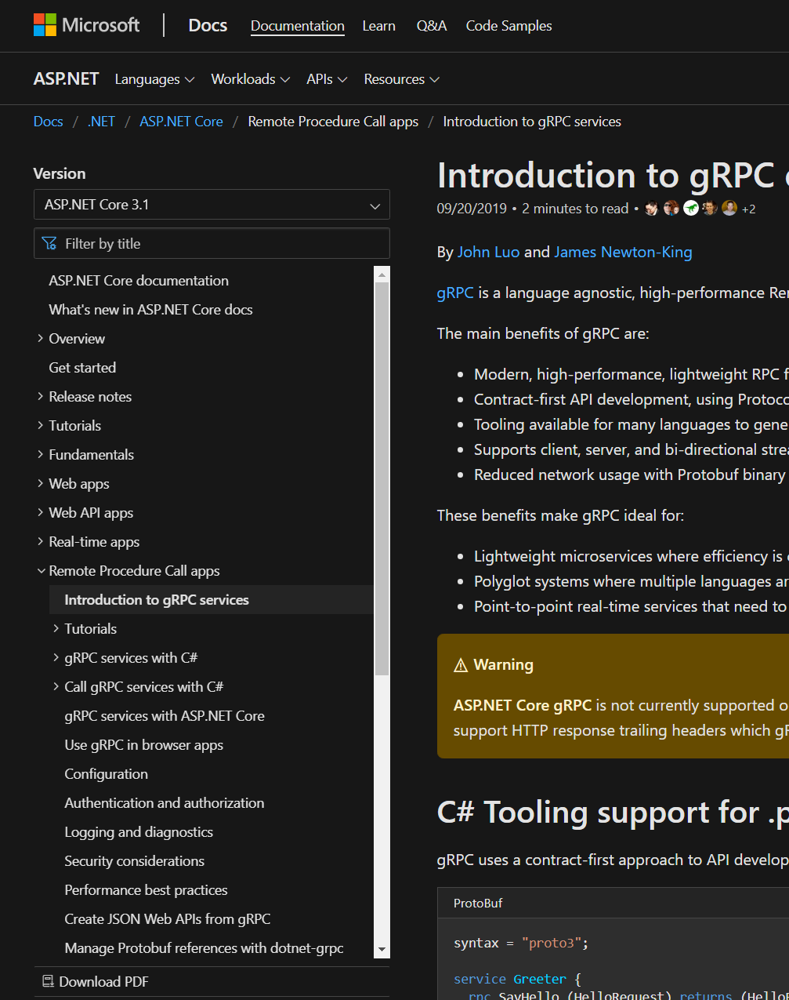
Resources – Docs
Intro tutorial
Creating gRPC services
Calling gRPC services
Create Protobuf messages
Versioning gRPC services
Use gRPC in browser apps
Create JSON Web APIs from gRPC
Performance best practices
And more
https://aka.ms/grpcdocs
Notes:
If you’re interested in using gRPC, lets talk about some of the resources available
We’ve spent a lot of time investing in documentation.
This is just a brief summary.
I recommend checking out the documentation first if you have any issues

Slide 12
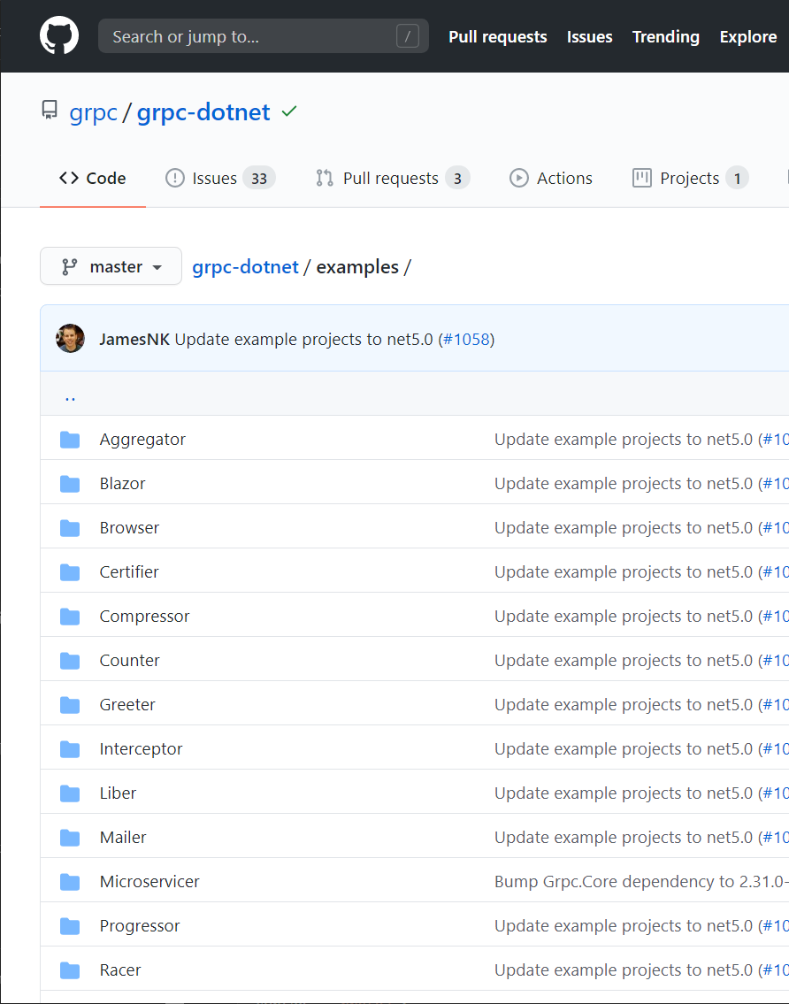
Resources – Examples
Hello world
Streaming
Certificate authentication
JWT authentication
OpenTelemetry
Unix domain sockets
Unit testing
Cancellation
And more
https://aka.ms/grpcexamples
Notes:
We’ve also written a lot of basic examples.
Each example shows one or two core concepts in act.
At last count there are 20 examples to explore.
You can find these on our GitHub repo

Slide 13

Thanks for joining !
Notes:
Thanks for your time.
I hope everyone has learnt something and is excited about gRPC on .NET 5
Hopefully we have some time for questions

